Slide 1

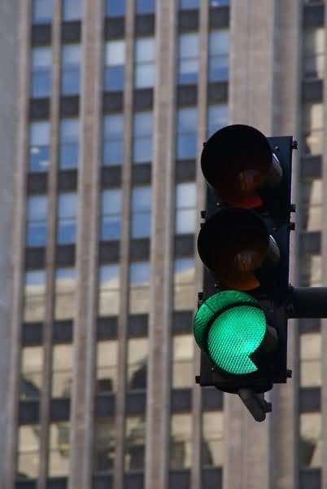

A MILP-Based Optimization of Traffic
Signal Timings for Congestion Reduction
and Dynamic Green Time Allocation
Presented by:
Priyanshi Agarwal – IED/10006/23
Aditi Roy – IED/10029/23

Slide 2
Optimizing Traffic Signal Timing Using MILP
Traditional methods (fixed-time, actuated control) are not responsive to changing urban traffic
Early adaptive methods (fuzzy logic, genetic algorithms) lack optimality and scalability
MILP models offer systematic optimization but often rely on complex queue modeling
Queue-based models need detailed data and are computationally intensive
Our Contribution
Propose a simple MILP model to maximize vehicles served per cycle
Uses saturation flow rates and real-time or forecasted demand
Avoids explicit modeling of queue dynamics
Includes practical constraints like total cycle length and green time bounds
Enables dynamic green time allocation and phase prioritization
Scalable and suitable for isolated intersections with limited data

Slide 3
Dataset and Preprocessing
Dataset: Open-source Hangzhou CityFlow dataset
Focused on intersection_1_1, an isolated junction in the urban road network
Data Sources
roadnet_4_4.json: Defines intersection structure, lanes, and signal phases
hangzhou_4_4.json: Contains time-stamped vehicle inflow data for each lane
Preprocessing Steps
Phase Extraction: Identify signal phases and active lanes
Demand Computation: Aggregate vehicle counts per phase over a fixed cycle (e.g., 240 seconds)
Saturation Flow Assignment: Assign flow rates (0.5–1.0 veh/sec) based on lane and phase characteristics
Peak-Time Filtering: Use data from high-traffic periods for realistic modeling

Slide 4
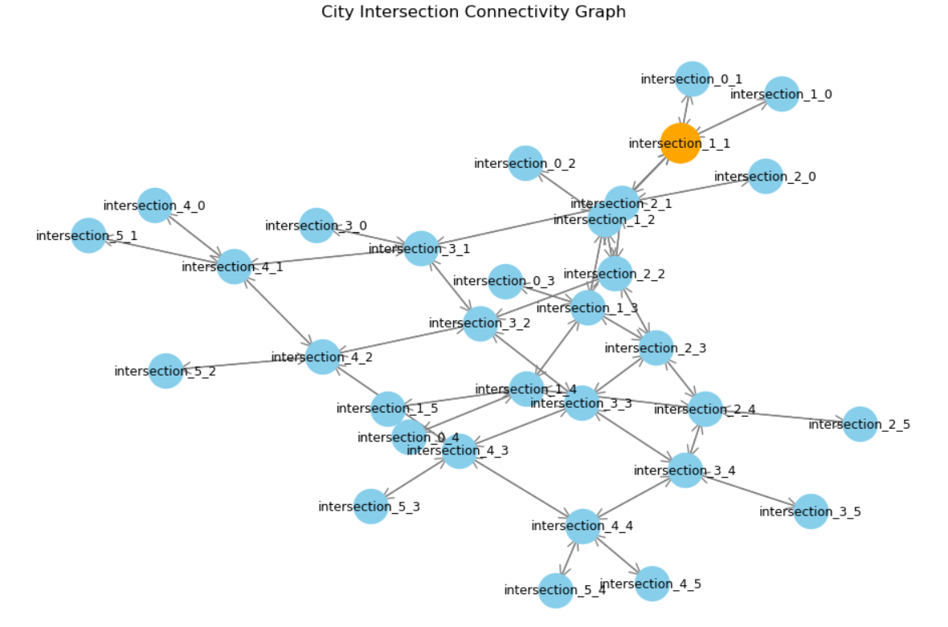

Slide 5
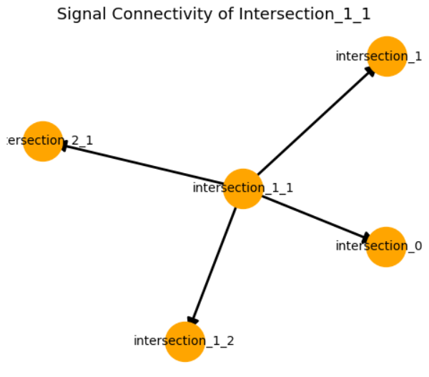

Slide 6
METHODOLOGY
Step 1: Demand Extraction
Phase-wise vehicle demand for intersection_1_1 is computed from CityFlow data by aggregating lane-wise inflow over a fixed cycle.
Step 2: MILP Formulation
A MILP model is built to maximize vehicles served by optimally allocating green time, under constraints like:Saturation flow limits, Vehicle demand,Total green time budget,Phase-wise time bounds.
Step 3: Solving the Model
Implemented using Python + PuLP, solved with CBC solver to obtain optimal green time allocation and vehicles served.
Step 4: Simulation Comparison
Optimized signal timings are compared to a fixed-time baseline through traffic simulation of vehicle flow and queue behavior.

Slide 7
PROBLEM DEFINITION
Objective: Optimize real-time traffic signal control at an isolated intersection to reduce congestion and maximize vehicles served per cycle.
Approach:
Formulated as a Mixed Integer Linear Programming (MILP) problem.
Decision Variables:
Green time allocated to each signal phase
Number of vehicles served per phase
Objective Function:
Maximize total vehicles served
Optional weights to prioritize high-demand directions
Key Constraints:
Saturation Flow: Vehicles served ≤ saturation flow × green time
Demand Limit: Vehicles served ≤ actual demand
Cycle Time: Total green time = fixed cycle duration
Green Time Bounds: Each phase must stay within min–max green time limits
Distinctive Features:
No explicit queue or phase sequence modeling (lightweight & efficient)
Easily re-solvable in real-time with updated demand
Suitable for data-constrained environments

Slide 8
OBJECTIVES
The objective of this study is to develop a dynamic traffic signal control model for an isolated
intersection that reduces congestion and enhances traffic flow by adjusting green time
durations based on real-time or forecasted traffic demand using a Mixed Integer Linear
Programming (MILP) framework.
The model aims to:
1. Maximize the Number of Vehicles Served
Allocate green time across signal phases to serve as many vehicles as possible, with
higher priority given to high-demand approaches.
2. Adapt to Dynamic Traffic Demand
Adjust green time durations in response to real-time or predicted traffic conditions
for more responsive and effective signal control.
3. Ensure Operational and Physical Feasibility
Enforce constraints such as total cycle time, saturation flow limits, green time
bounds, and demand caps to ensure realistic and safe signal operation.
4. Promote Fairness Across All Movements
Prevent the neglect of low-demand directions by maintaining minimum green time
allocations and balanced service levels.
The objective of this study is to develop a dynamic traffic signal control model for an isolated
intersection that reduces congestion and enhances traffic flow by adjusting green time
durations based on real-time or forecasted traffic demand using a Mixed Integer Linear
Programming (MILP) framework.
The model aims to:
1. Maximize the Number of Vehicles Served
Allocate green time across signal phases to serve as many vehicles as possible, with
higher priority given to high-demand approaches.
2. Adapt to Dynamic Traffic Demand
Adjust green time durations in response to real-time or predicted traffic conditions
for more responsive and effective signal control.
3. Ensure Operational and Physical Feasibility
Enforce constraints such as total cycle time, saturation flow limits, green time
bounds, and demand caps to ensure realistic and safe signal operation.
4. Promote Fairness Across All Movements
Prevent the neglect of low-demand directions by maintaining minimum green time
allocations and balanced service levels.

Slide 9
Decision Variables
Gₚ — ℝ, Gₚ ≥ 0
Total green time allocated to phase p during the signal cycle
servedₚ — ℝ, servedₚ ≥ 0
Number of vehicles served during phase p
gₚₜ — {0, 1}
1 if phase p is green at time t, 0 otherwise
γₚₜ — {0, 1}
1 if green starts for phase p at time t, 0 otherwise
Continuous Variables
Gₚ — green time allocated to phase p
servedₚ — vehicles served during phase p
Binary Variables
gₚₜ =1, if phase p is green at time t
0, otherwise
γₚₜ =1, if green starts for phase p at time t
0, otherwise

Slide 10
OBJECTIVE FUNCTION
This objective seeks to maximize the total number of vehicles served, giving priority to high-
demand phases through the use of a weight factor wₚ

Slide 11
CONSTRAINTS:
1. Total Green Time Constraint
∑Gₚ = G_total
→ The sum of green times for all signal phases must equal the total cycle time.
2. Saturation Flow Constraint
servedₚ ≤ sₚ × Gₚ
for all p ∈ P
→ The number of vehicles served during phase p cannot exceed its saturation
flow rate multiplied by its green time.
3.Demand Constraint
servedₚ ≤ dₚ
for all p ∈ P
→ You cannot serve more vehicles than the actual demand for any phase.
4.Green Time Bounds
G_min ≤ Gₚ ≤ G_max
for all p ∈ P
→ Each phase's green time must stay within allowed minimum and maximum
bounds.

Slide 12
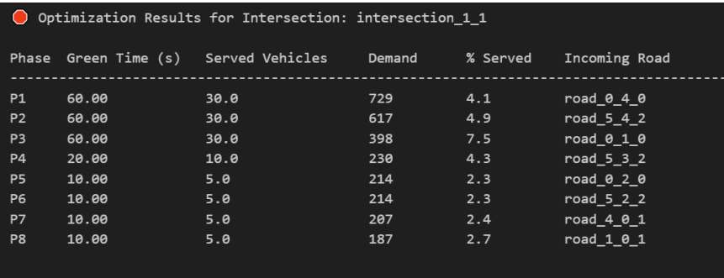
SIMULATION AND RESULTS:
To assess the effectiveness of the proposed MILP-based optimization, we
conducted a comparative simulation between traditional fixed-time signal
control and the proposed demand-responsive optimized control at the
isolated intersection intersection_1_1.
6.1 Performance Comparison
The baseline approach allocates green time equally to all signal phases,
regardless of traffic volume. In contrast, the MILP model adjusts green durations
dynamically based on actual phase-wise demand and saturation flow constraints.
A summary of the key performance is shown below:

Slide 13
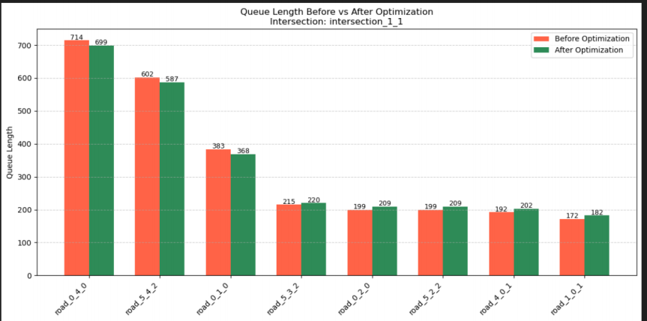
SIMULATION AND RESULTS:

Slide 14
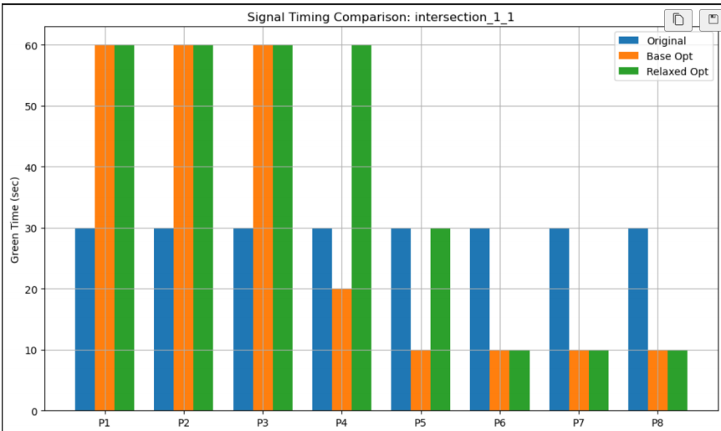
SIMULATION AND RESULTS:

Slide 15
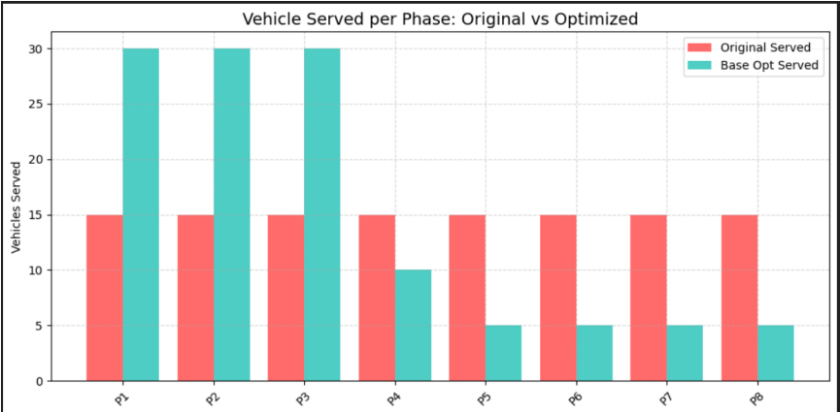
SIMULATION AND RESULTS:

Slide 16
Key Contributions and Future Work
Developed a MILP-based model for dynamic green time allocation at an isolated intersection using real traffic data.
Outperformed fixed-time control by serving more vehicles, especially during high-demand phases.
Ensured feasibility with constraints on green time, saturation flow, and demand.
Demonstrated real-world impact of mathematical optimization in urban traffic control.
Built a Streamlit dashboard for interactive testing.
Future Enhancements:
Extend to multi-intersection coordination.
Model queue build-up and dissipation over time.
Use real-time inputs from detectors or cameras (e.g., YOLOv8).
Combine MILP with reinforcement learning for adaptive control.
Include pedestrians and emergency vehicle handling.

Slide 17

THANK YOU

